Slide 1
GETTING STARTED WITH REACT & REDUX

Slide 2
What is React.js?
A JavaScript library for building user interfaces. Reactjs is created by the Facebook for the V of MVC by reusable and interactive UI components.

Slide 3
Why React.js?
V(view) of MVC - Solution of View in MVC
Virtual DOM - Reactjs use the concept of virtual DOM which helps in the performance
Unidirectional Data Flow - Compare to the 2 way data binding. Reactjs use the concept of Unidirectional data flow which improve the over all performance.
UI Components - Reusable and interactive components
SEO Friendly - Components are client side as well as server side render hence they are SEO friendly and no 3rd party plugin required
Coding is simpler because of JSX
Reactjs own debugger
React Native is going to be next big thing
Big minds are backing Reactjs

Slide 4
Core Concept of Reactjs
JSX
Components
Unidirectional dataflow
Virtual DOM

Slide 5
JSX
JSX - javascript XML syntax transform.
It helps in making our writing code easier and faster. JSX lets us writeHTML (not 100%) with XML based object representation.

Slide 6
Components
In Reactjs the whole application is break into the components. Components are interactive, reusable and stageful too.

Slide 7
Unidirectional Data Flow
- As compare to other MVC frameworks/Library Reactjs use the concept of unidirectional data flow.
- In Reactjs application the data flow from the parent to the children component by the state and the props.
- Only one parent is responsible to update the states and passing the value to the children components via props.
- setState is used to update/refresh the UI when the state change and the value can be pass to the children component by the this.props

Slide 8
Virtual DOM
Reactjs uses the concept of the virtual DOM.
It selectively render the subtree of DOM elements into the rendering of the DOM on state change
Use different algorithm with the browser DOM tree to identify the changes
Instead of creating new object, Reactjs just identify what change is took place and once identify update that state.
This way it is creating a virtual DOM and improving the performance too
Can be render on server and sync on Local

Slide 9
Components
Everything in reactjs is components. The core building
blocks of React application is components only.
Components interact with each other and maintain the state too. In Reactjs whole application is need to be break into the component only.

Slide 10
props
In Reactjs props are like the HTML Properties. They are used to pass the data between the components or via the states. In Reactjs the props can be accessed by this.props.propsname
Props can be define by name=“value”. To access this we have to call this.props.name

Slide 11
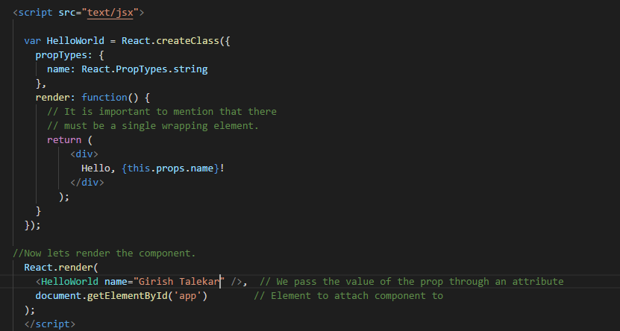

Slide 12
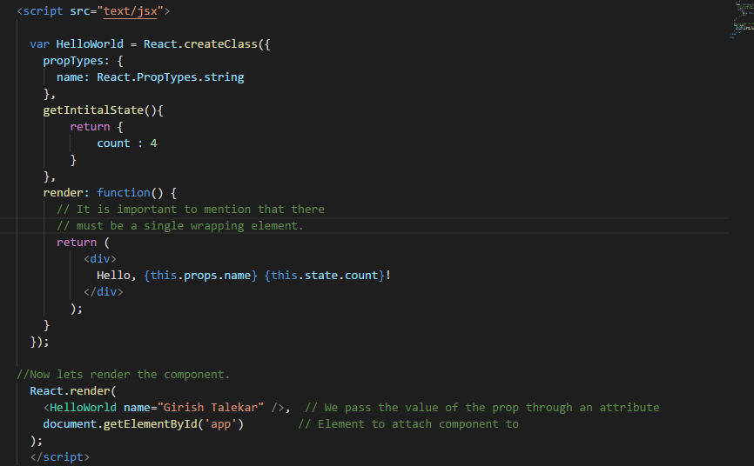
states
Every component has a State object. Can be set by using setState. setState triggers UI updates and to get the initial state before the setState : getInitialState.getDefaultProps

Slide 13
Component Lifecycle
componentWillMount – Client and server side componenet Will Occur only once (before)
componentDidMount – Only once (after)
shouldComponentUpdate – Return value determines weather component should update
componentWillUnmount – Before unmounting component

Slide 14
Events
Reactjs has the events that are attached with the components as the props of the components and can trigger methods.

Slide 15
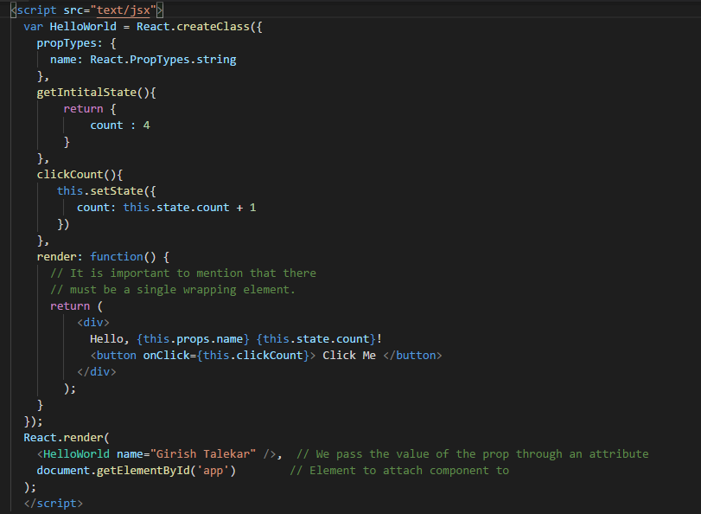

Slide 16
Unidirectional Data Flow
In reactjs, application data flows unidirectional via the state and props not like angular js where we have 2-way data binding. Which means in multiple component hierarchy , a common parent component should manage the state and pass it down the chain by props.
setState - state should be updated by setState to ensure UI will refresh/update
this.props – to pass the value to the child components

Slide 17
Redux
Data Flow :
Redux architecture revolves around a strict unidirectional data flow.
This means that all data in an application follows the same lifecycle pattern, making the logic of your app more predictable and easier to understand. It also encourages data normalization, so that you don't end up with multiple, independent copies of the same data that are unaware of one another.

Slide 18
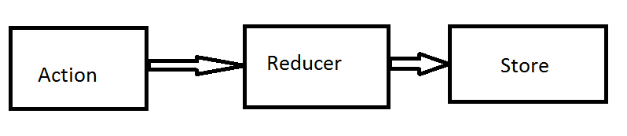
Redux basic blocks
The data lifecycle in any Redux app follows these 4 steps:
You call store.dispatch(action).
The Redux store calls the reducer function you gave it.
The root reducer may combine the output of multiple reducers into a single state tree.
The Redux store saves the complete state tree returned by the root reducer.

Slide 19
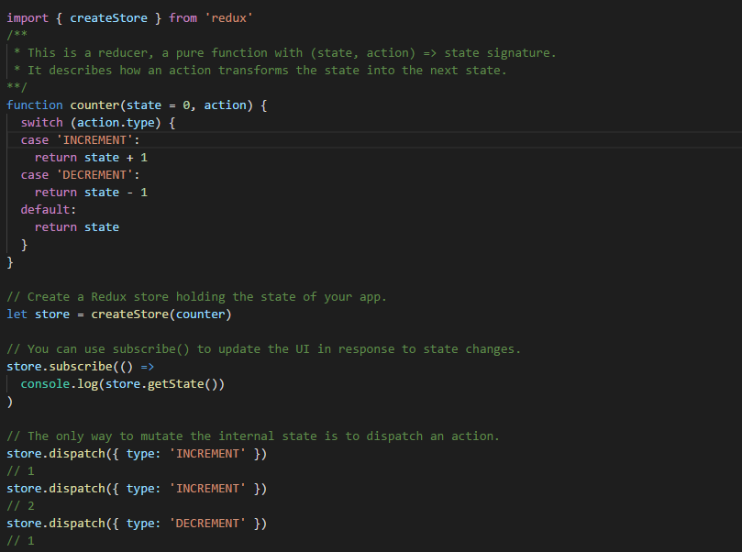

Slide 20
Project link
https://github.com/girishg4t/react-native-with-redux-sample
https://github.com/girishg4t/reactBoilerplate

Slide 21
Configuration Local
Local setup (https://facebook.github.io/react-native/docs/getting-started.html)
Debugging

Slide 22
Thanks

